Slide 1

Trend Analysis - YouTube
Radhika Sood, Rajat Srivastava, Rohit Thakur, , Salil Tari, Zhu Wen

Slide 2
Overview
Statistical analysis for the YouTube videos
Number of Views, Likes, Share, Comments
Formats: Json and CSV
Data Source: Kaggle

Slide 3
Technologies Used
Azure Server
Databricks
PySpark
Tableau
Spark SQL

Slide 4
Challenges Faced
Dataset
Data Integration
EDA
GCP
Google Datasets

Slide 5
Data Integration

Slide 6
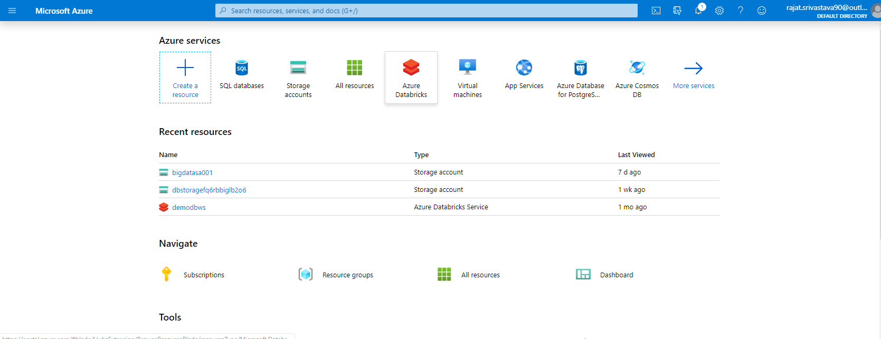

Slide 7
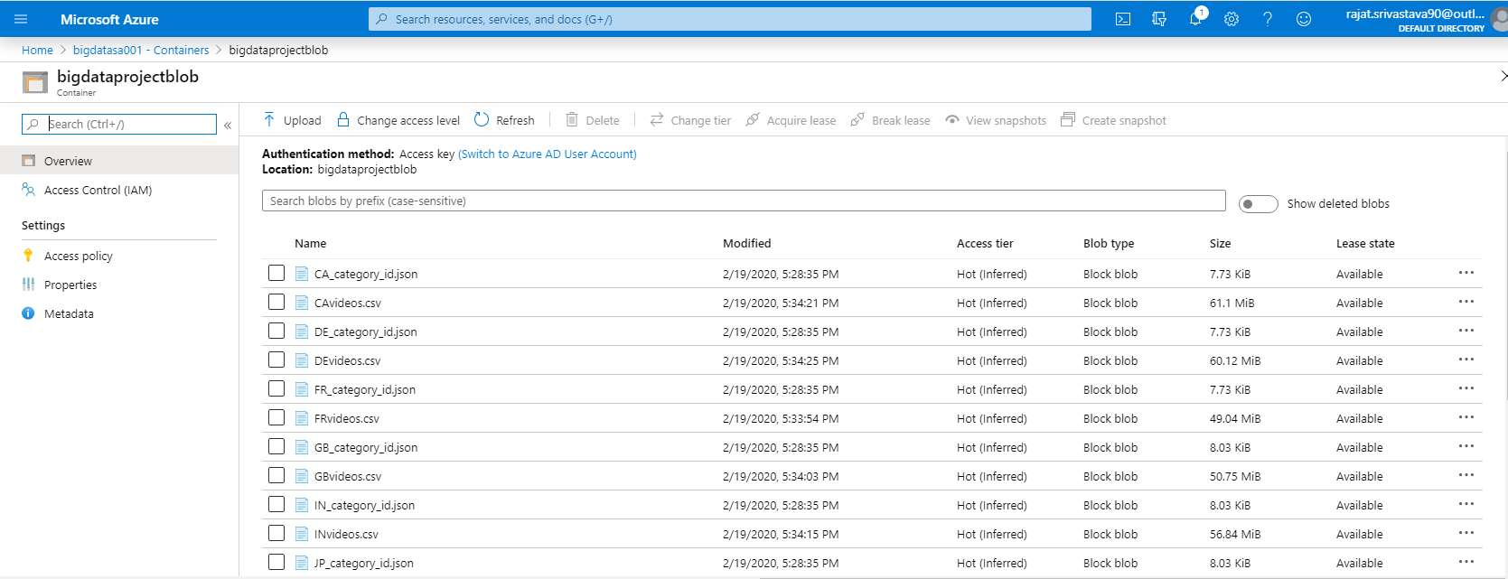

Slide 9
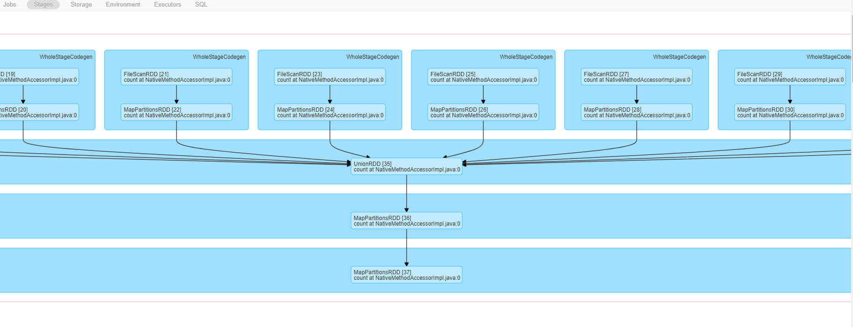
DAG Visualization

Slide 10
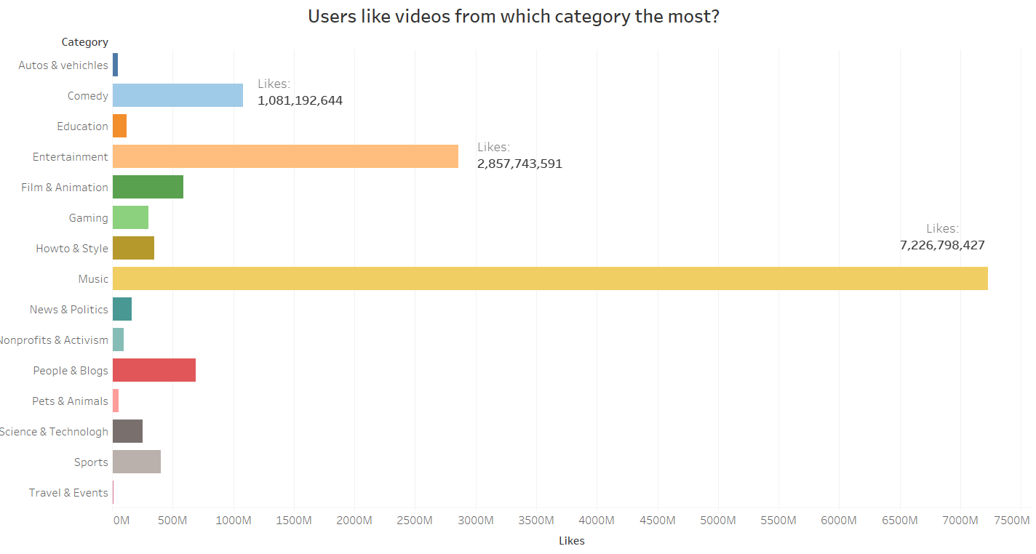
Data Analysis
The music category got most likes from audience, followed by entertainment and then comedy.

Slide 11
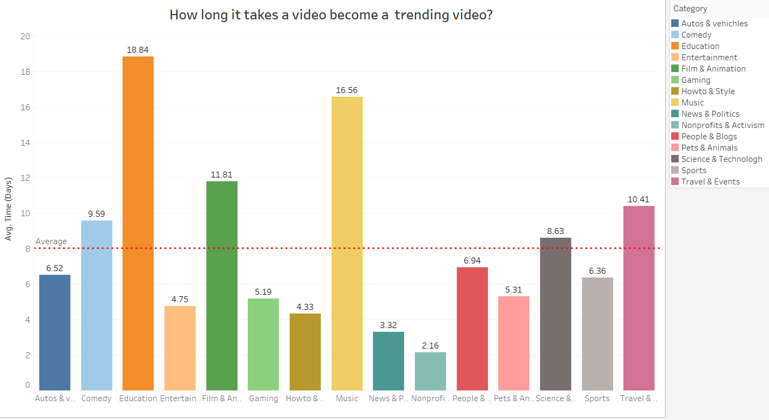
Data Analysis
It took average 8 days for a video to become a trending video. Education videos took the longest time.

Slide 12
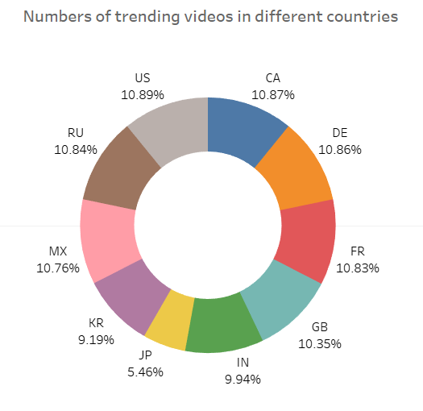
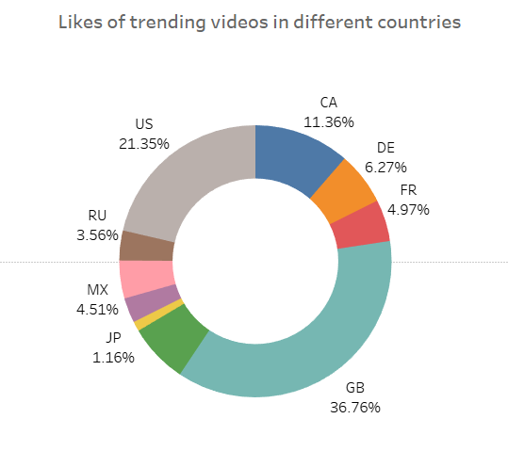
Data Analysis
Trending videos distributed relatively even in different countries. However, videos from GB (Great Britain) were the most popular followed by videos from US.

Slide 13
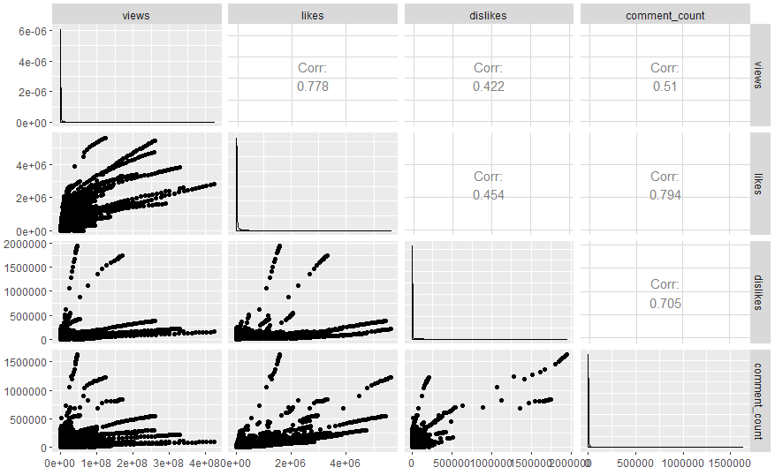
Data Analysis
There is a strong positive relationship between likes and views, which means that a video had more likes are more likely to become a trending video.
The dislikes and comments a video had did not affect views significantly.
Additionally, audience who liked the video were more willing to give comments when compared with audience who disliked the video.

Slide 14
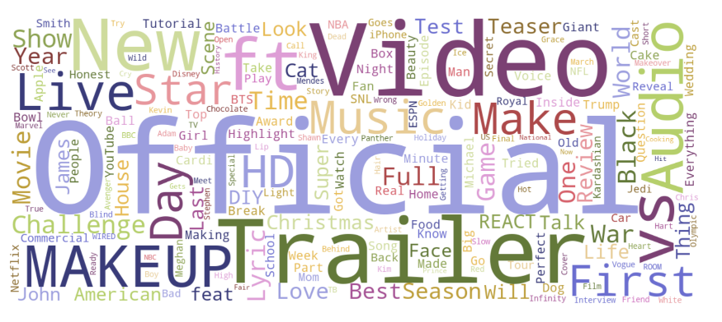
Data Analysis

Slide 15
Next Steps
Predictive Modeling
Sentiment Analysis
Gather Live Data

Slide 16
Q & A

